Slide 1


Applied Data Science Capstone
The battle of neiborhoods

Slide 2
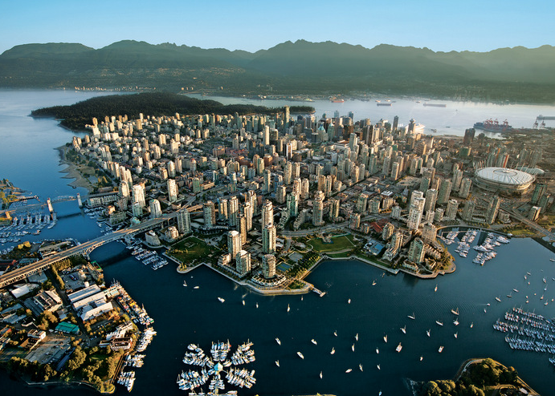
Introduction
With its scenic views, mild climate, and friendly people, Vancouver is known around the world as both a popular tourist attraction and one of the best places to live. It is also one of the most ethnically and linguistically diverse cities in Canada.
Vancouver is made up of a few smaller neighbourhoods and communities. Neighbourhood boundaries provide a way to break up the city’s large geographical area for delivering services and resources and identify the distinct culture and character of different areas of our diverse population.

Slide 3
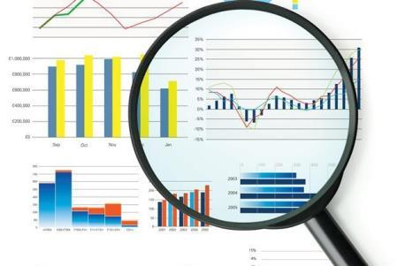
Goals
In this project, we will study, analyze, cluster, and compare the neighborhoods of Vancouver. We will investigate on what kinds of businesses are most common in the city, which outdoors and recreation activities and what kinds of restaurants are most common between the neighborhoods.

Slide 4
Data Acquisition and Preparation
The process of acquiring, cleaning, and preparing the dataset used in this project for the next stages will be specified. To be able to do this project, two types of data are needed:
Neighborhood Data: datasets with the list names of the neighborhoods of Vancouver and their latitude and longitude coordinates. The neighborhoods names were obtained in the website of Vancouver (https://vancouver.ca/news-calendar/areas-of-the-city.aspx) and the latitude and longitude data were obtained using a recursive function that would return the geocode of the address passed into it.
Venues Data: data that describes the top 100 venues (restaurants, cafes, parks, museums, etc) in each neighborhood of Vancouver. The data should list the venues of each neighborhood with their categories. This data will be retrieved from Foursquare which is one of the world largest sources of location and venues data. Foursquare API will be utilized to get and download the data.

Slide 5
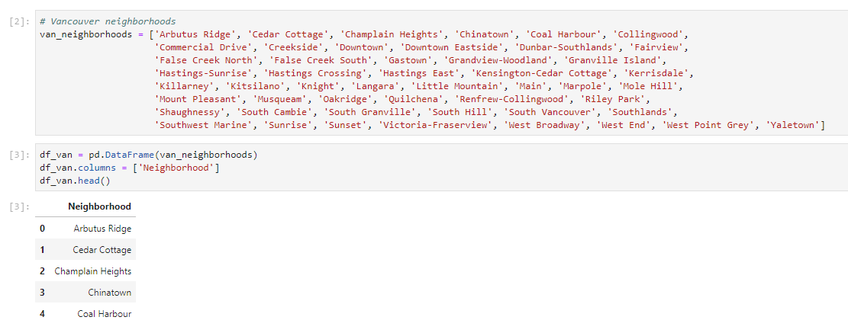
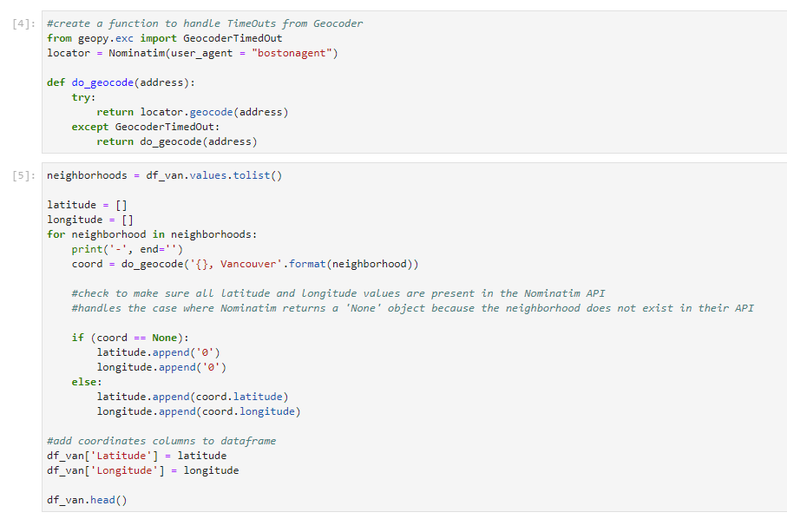
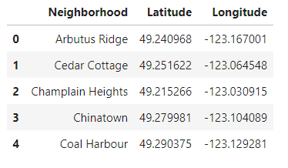
Neighborhood Data – Vancouver
A dataset was created from the combination of two sources.

Slide 6
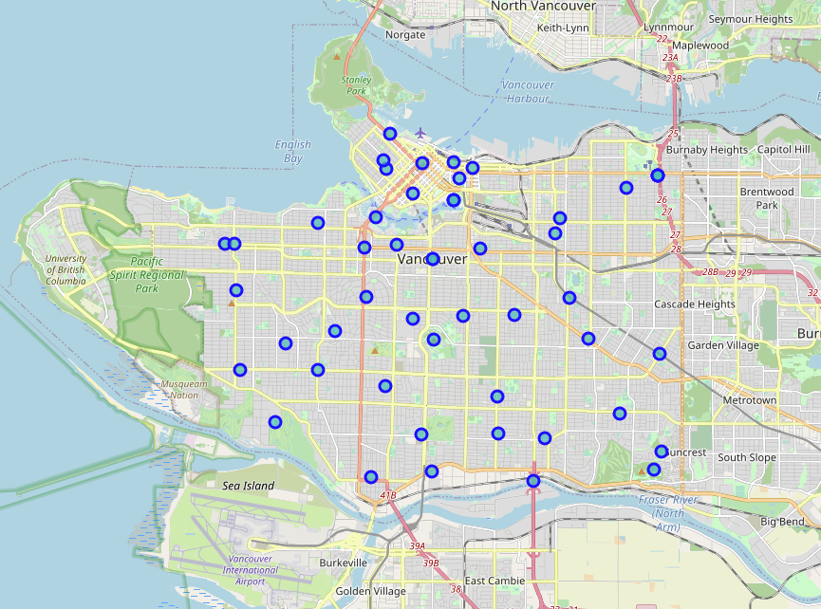
Neighborhood Data – Vancouver
A map of Vancouver and its neighborhoods.

Slide 7

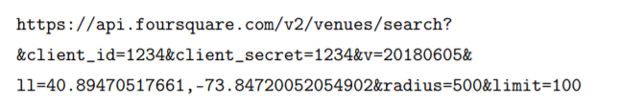
Venues Data – Vancouver
For the city, data that describes the venues of its neighborhoods and the categories of these venues is needed.
Foursquare API service will be utilized to access and download venues data. To retrieve data from Foursquare using their API, a URL should be prepared and used to request data related a specific location. An example URL is the following:

Slide 8
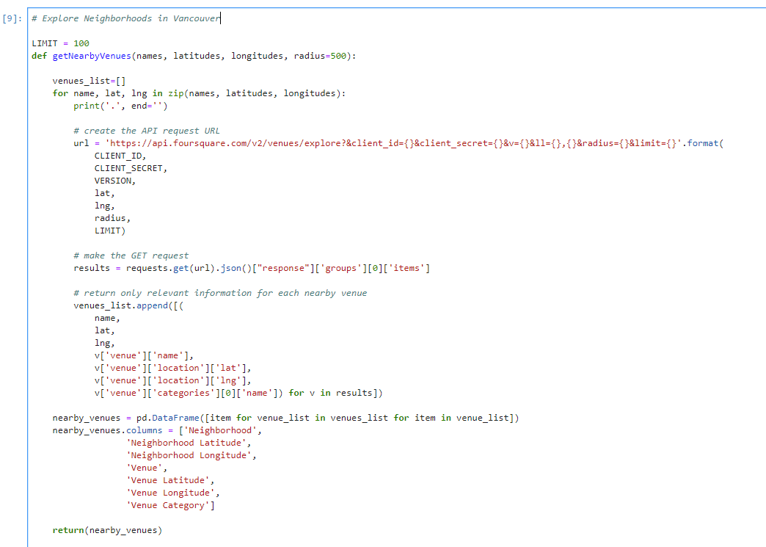
Venues Data – Vancouver
The code used to create a function that takes as input the names, latitudes, and longitudes of the neighborhoods, and returns a dataframe with information about each neighborhood and its venues.

Slide 9
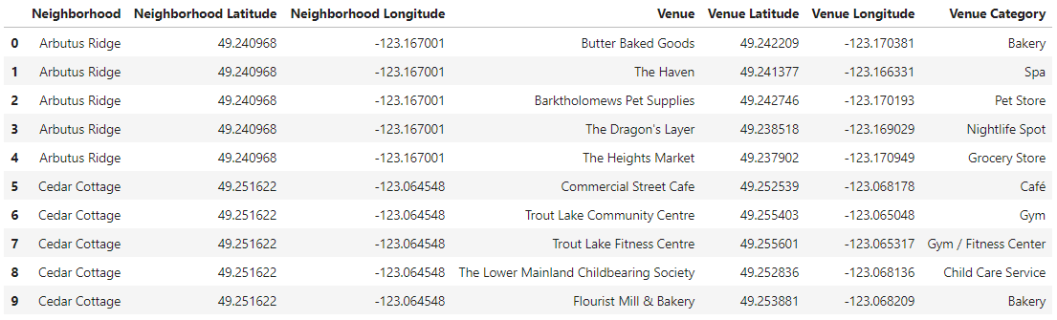
Venues Data – Vancouver
The head of the dataframe returned by the function for Vancouver.

Slide 10
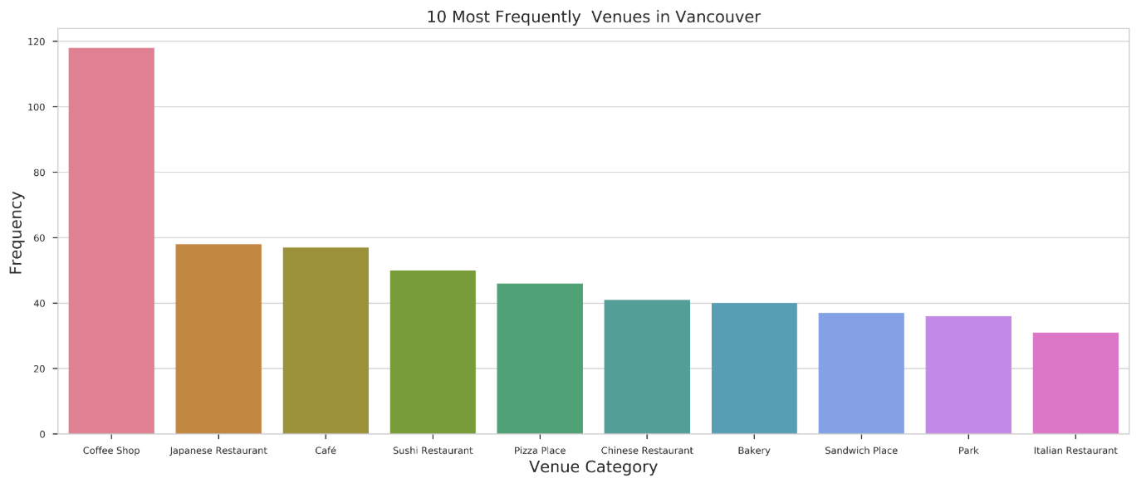
Exploratory data Analysis – Vancouver
Most Common Venue Categories (All categories).

Slide 11
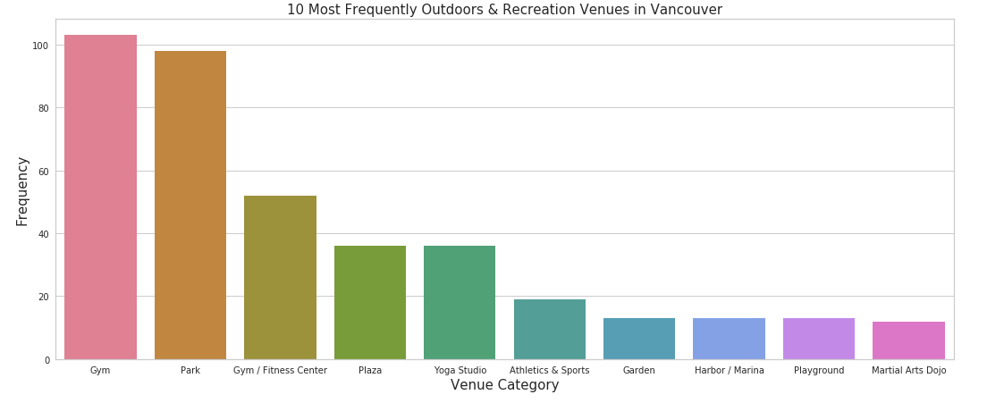
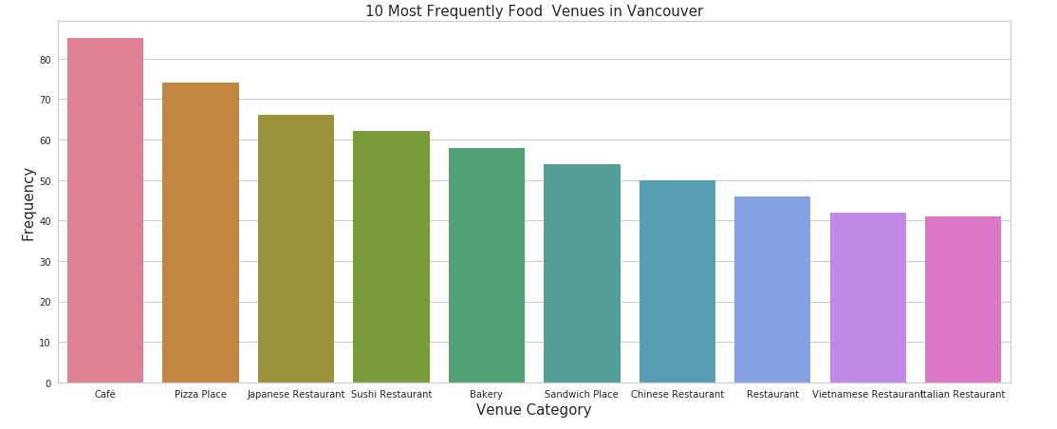
Exploratory data Analysis – Vancouver
Most Common Venue - Outdoors & Recreation Categories.
Most Common Venue - Food Categories.

Slide 12
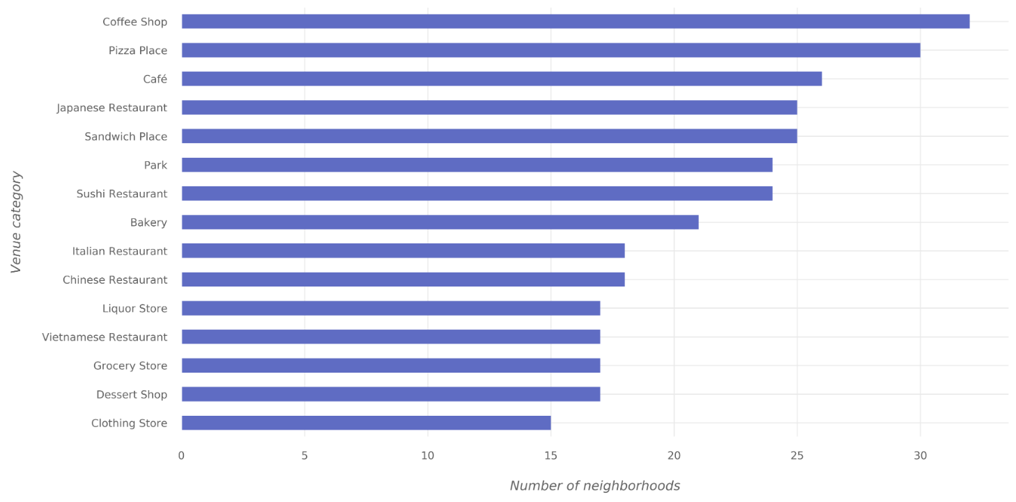
Exploratory data Analysis – Vancouver
Most Widespread Venue Categories (All categories).

Slide 13
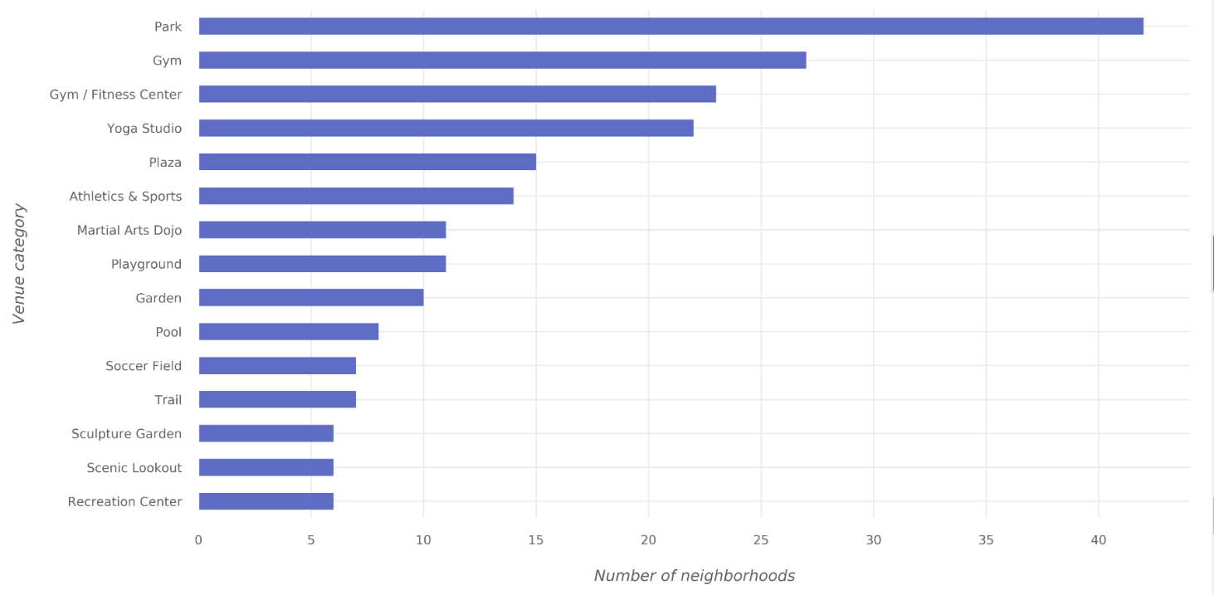
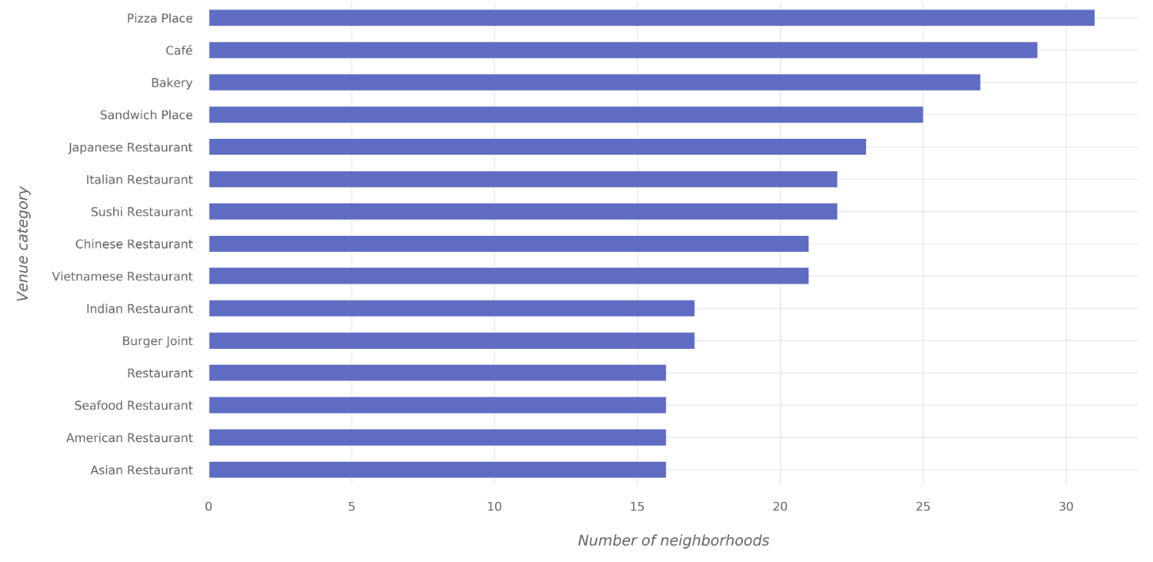
Exploratory data Analysis – Vancouver
Most Widespread Venue - Outdoors & Recreation Categories.
Most Widespread Venue - Food Categories.

Slide 14
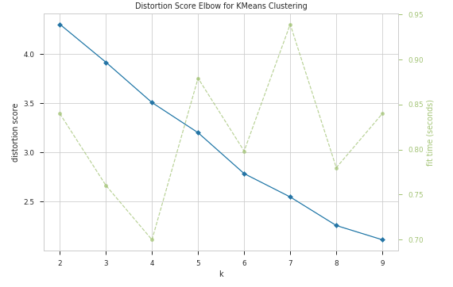
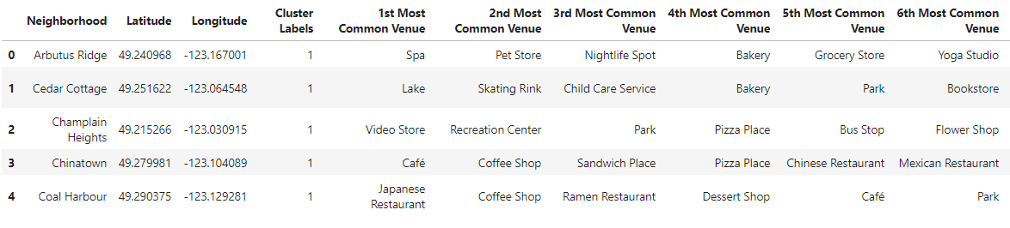
Clustering of Neighborhoods – Vancouver
Clustering will be applied on Vancouver neighborhoods to find similar neighborhoods in the city.. In particular, K-means clustering algorithm of the Scikit-learn Python library will be used.
Using Elbow method for the value of k.
Dataset with cluster labels.

Slide 15
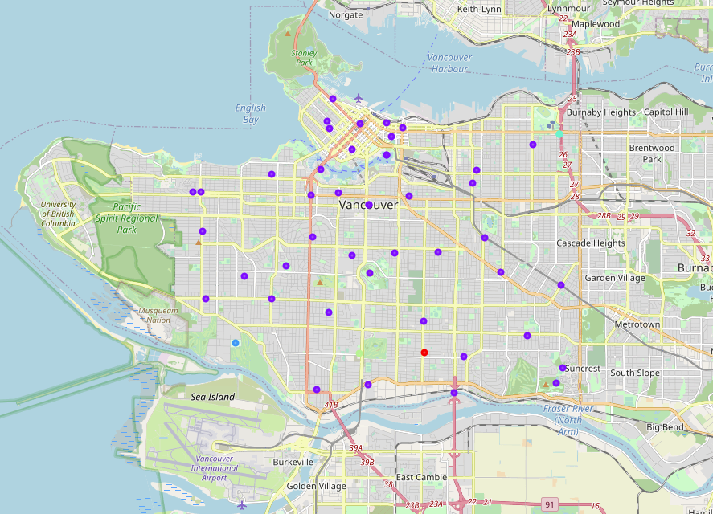
Clustering of Neighborhoods – Vancouver
Map with the 5 clusters for all venue categories .

Slide 16
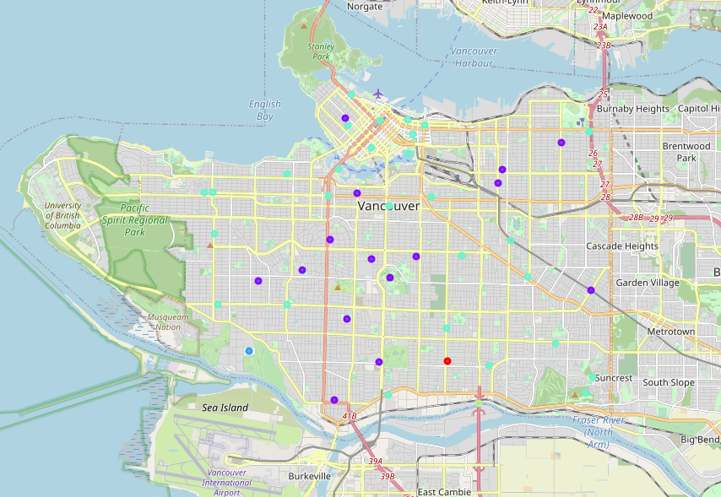
Clustering of Neighborhoods – Vancouver
Map with the 5 clusters for Outdoors & Recreation categories .

Slide 17
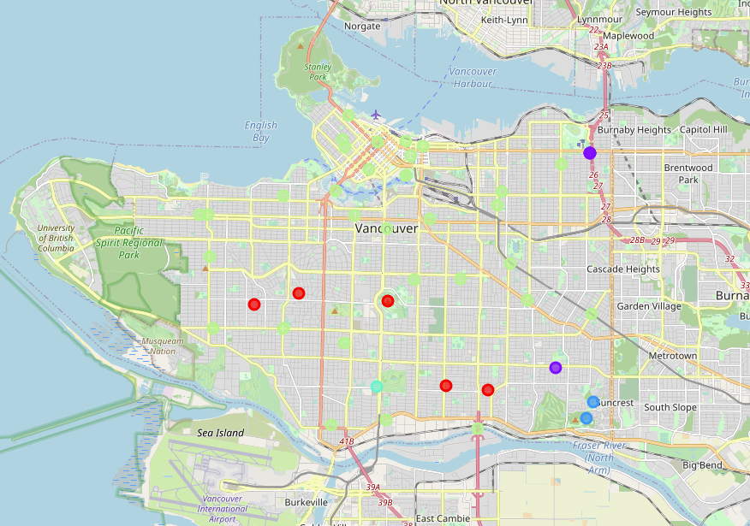
Clustering of Neighborhoods – Vancouver
Map with the 5 clusters for Food categories .

Slide 18
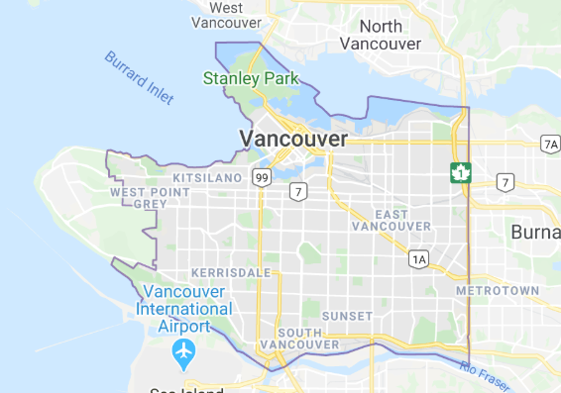
Conclusions
In this project, the neighborhoods of Vancouver were clustered into multiple groups based on the categories (types) of the venues in these neighborhoods. The results showed that there are venue categories that are more common in some cluster than the others; the most common venue categories differ from one cluster to the other. If a deeper analysis—taking more aspects into account—is performed, it might result in discovering different style in each cluster based on the most common categories in the cluster.

